Slide 1
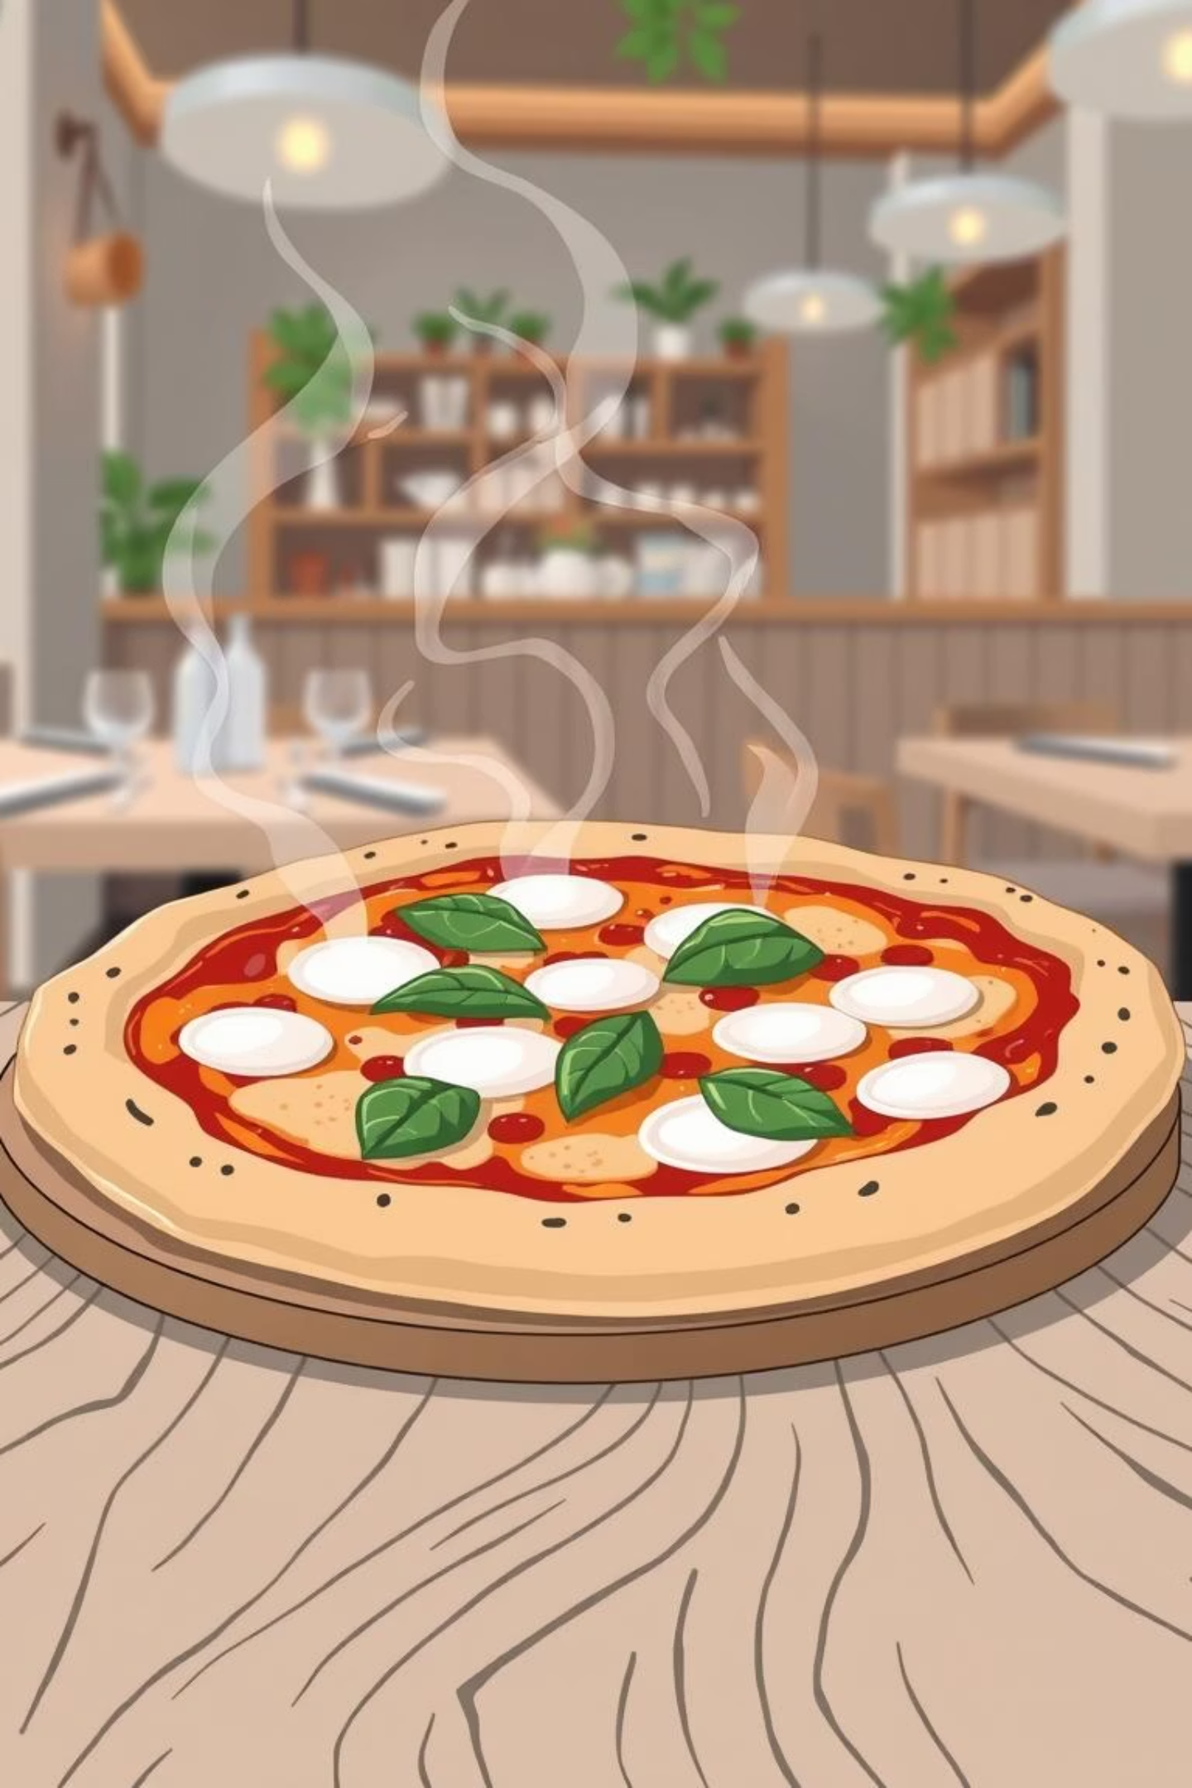
Bella Italia: Crafting the Perfect Order Experience

Slide 2
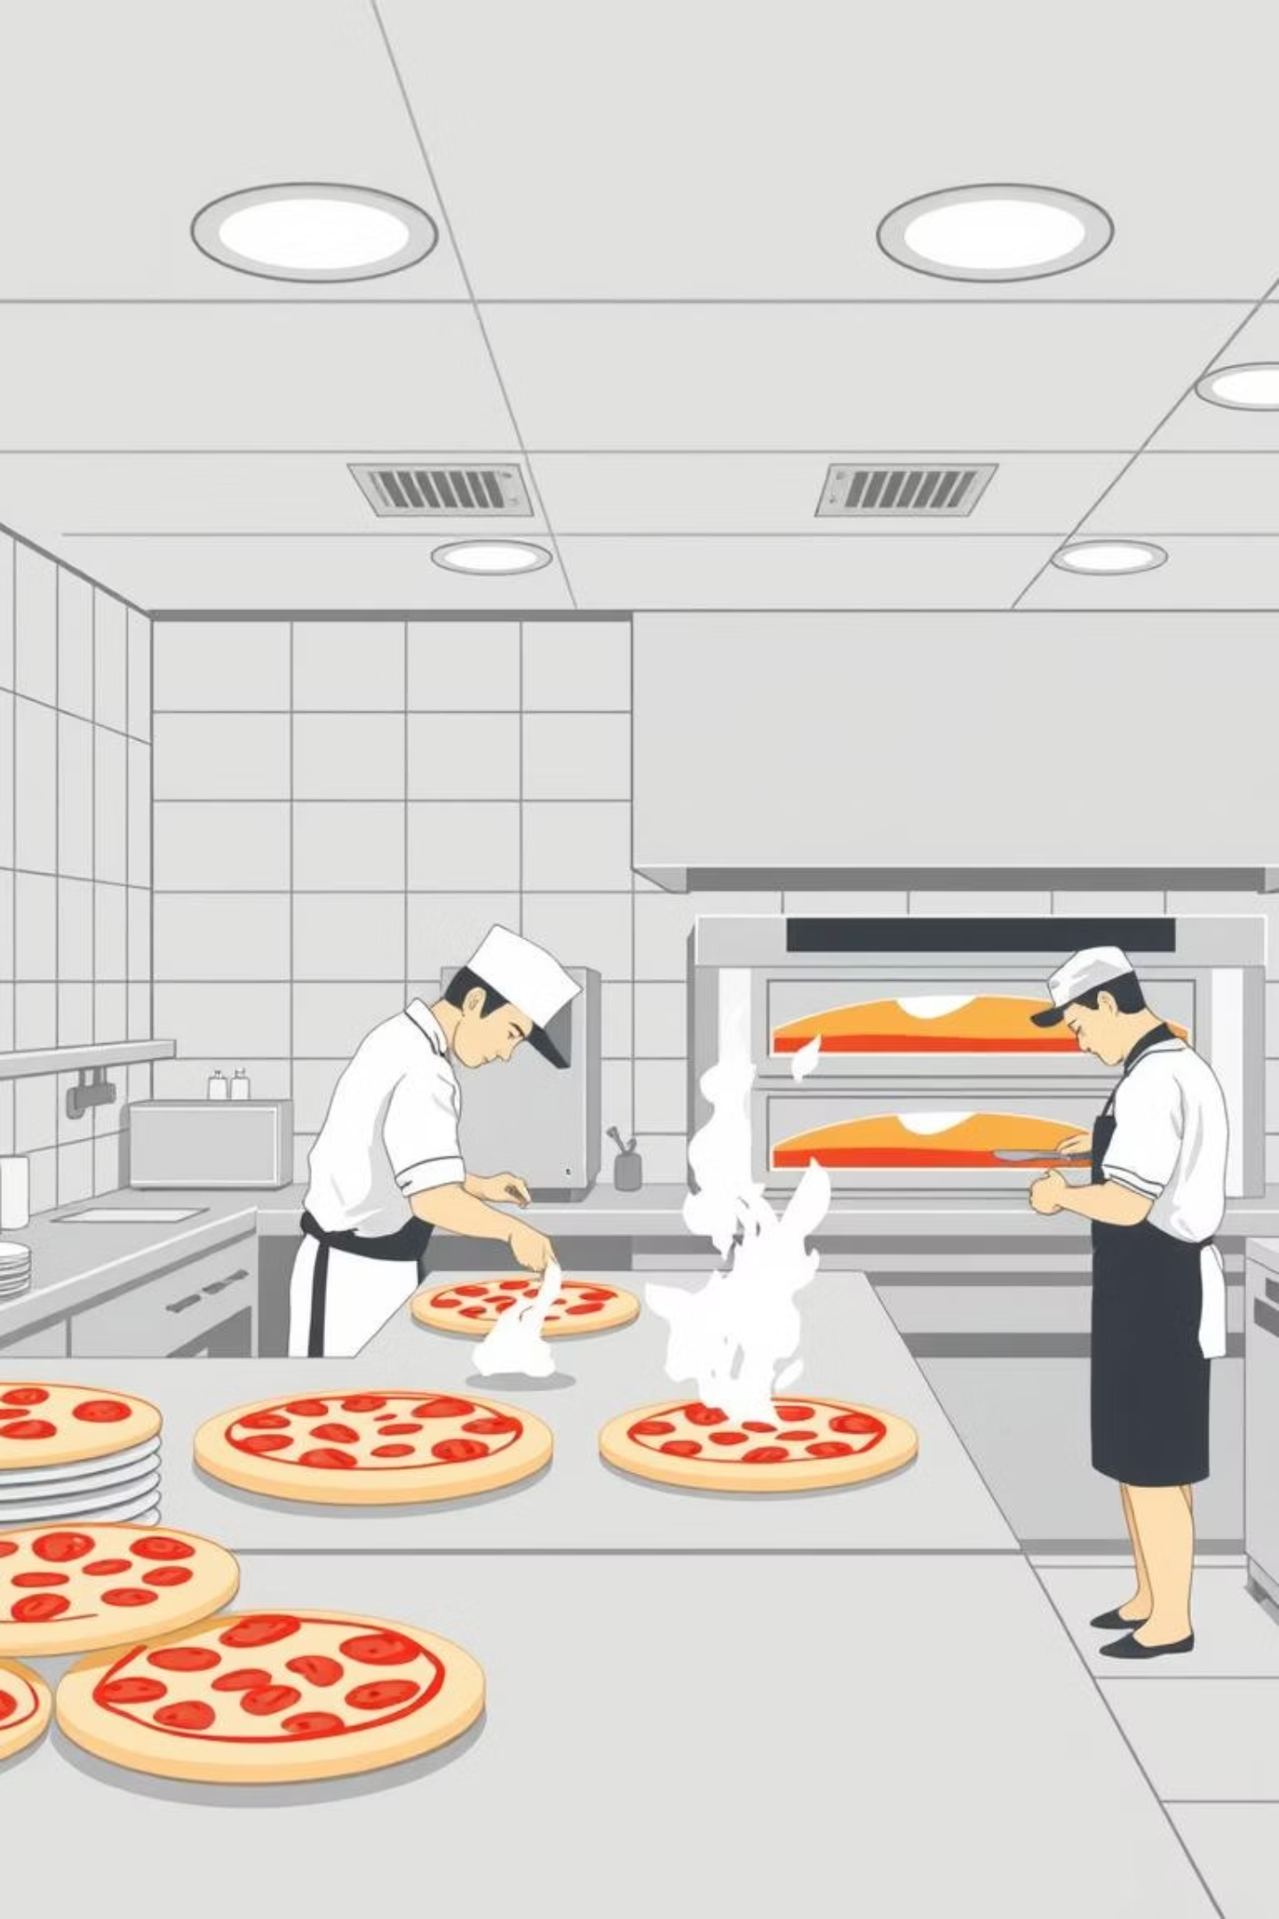
About Bella Italia: A Beloved Pizzeria
Bella Italia is a fictional pizzeria proudly serving its community through a variety of channels, striving to deliver delicious food and excellent service.
In-Person Requests
Phone Calls
Customers ordering directly at the counter, enjoying the ambiance.
Traditional phone orders, a staple for many loyal customers.
Website Ordering
Offering convenience for those who prefer digital interactions.

Slide 3





Core Ordering Problems:
Bella Italia faces several significant challenges in its existing ordering infrastructure, leading to inefficiencies and potential customer dissatisfaction.
Partially Working Website
The current Pizza Italia website is not fully functional, with incomplete features.
Manual Ordering System
Charlotte manually searches through scattered notes and documents to track orders.
Unstructured Phone Orders
Phone orders lack automated blacklist/whitelist checking or accurate time estimations.
No Order Tracking
There's no system to track the cooking and delivery stages of an order.

Slide 4






Key Client Requirements:
Based on interviews and analysis, these are the essential features and functionalities required for the new system.
Automate Ordering System
Blacklist/Whitelist Checks
Implement an automated system that handles order placement, validation, and processing across all channels.
Automatically decline orders from blacklisted customers and prioritize whitelisted ones for improved service.
Automated Phone Confirmation
Payment Method Support
Accept multiple payment options including credit/debit cards, mobile wallets (Apple Pay, Google Pay), online banking, and cryptocurrency.
Ensure a phone call is made to the customer after a successful order placement on the website.

Slide 5
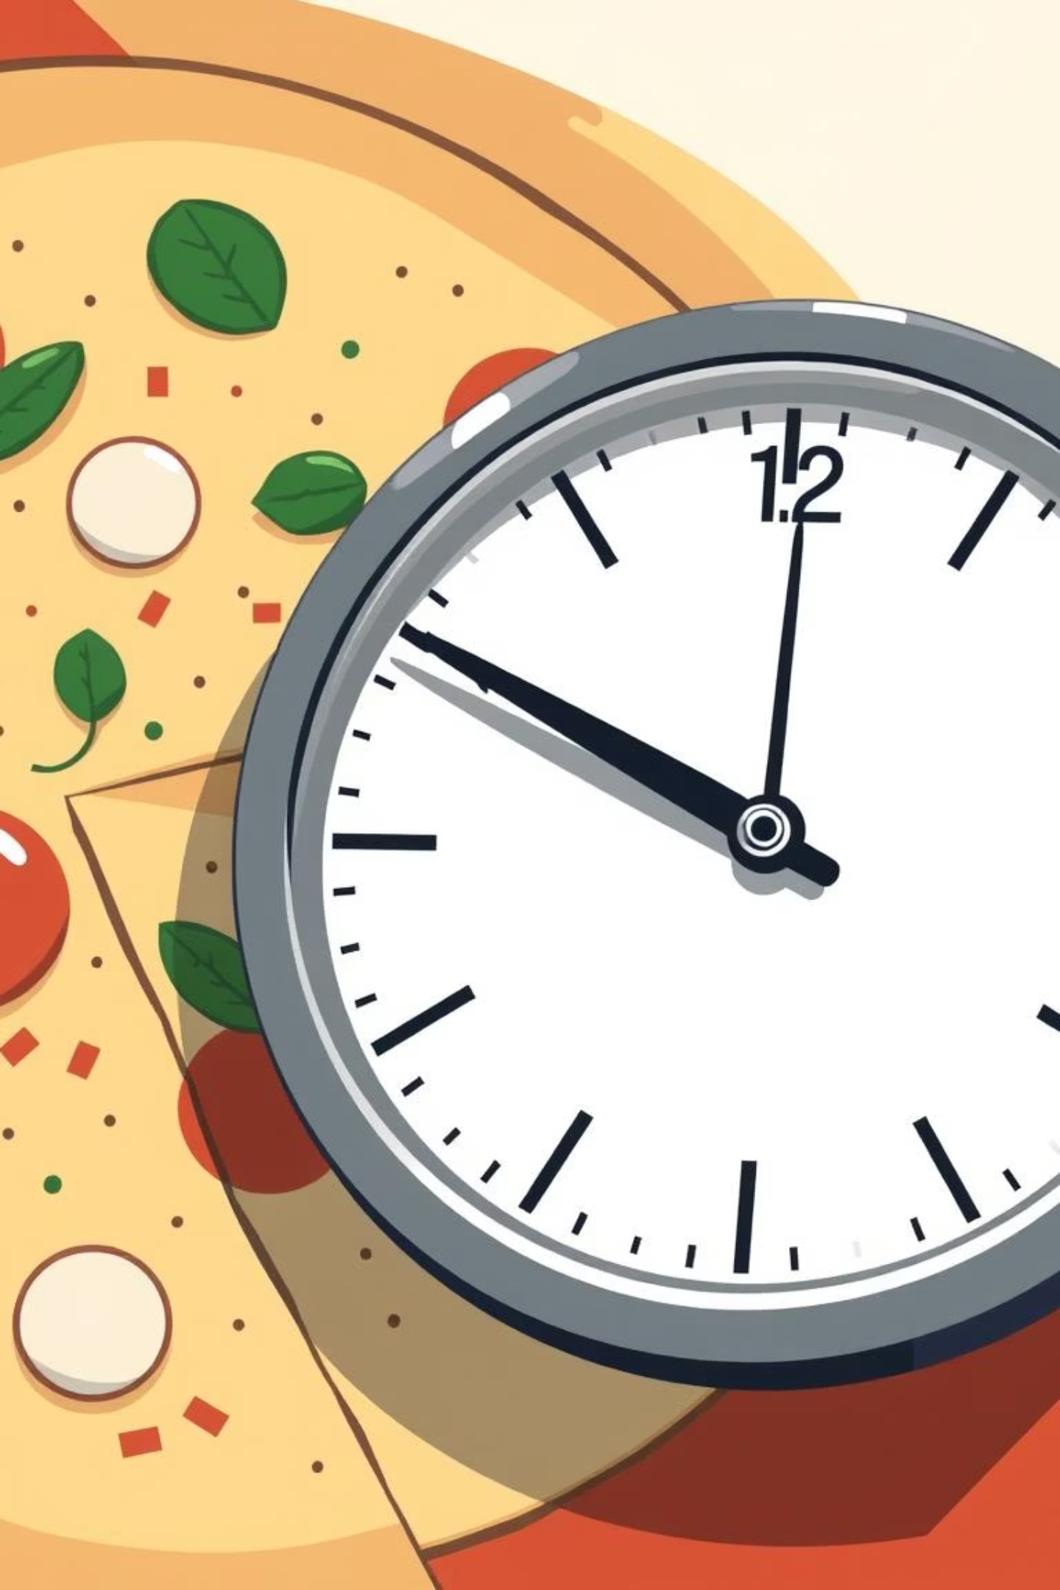



ETA System Requirement
Accurate estimated times for cooking and delivery are crucial for customer satisfaction and operational efficiency.
Cooking Time Calculation
Automatically calculate estimated cooking times for every pizza type, considering current kitchen load.
Delivery Time Prediction
Implement smart algorithms to predict delivery times based on distance, traffic, and driver availability.
Unified ETA Across Channels
Provide consistent and reliable ETA information for in-person, phone, and website orders.

Slide 6
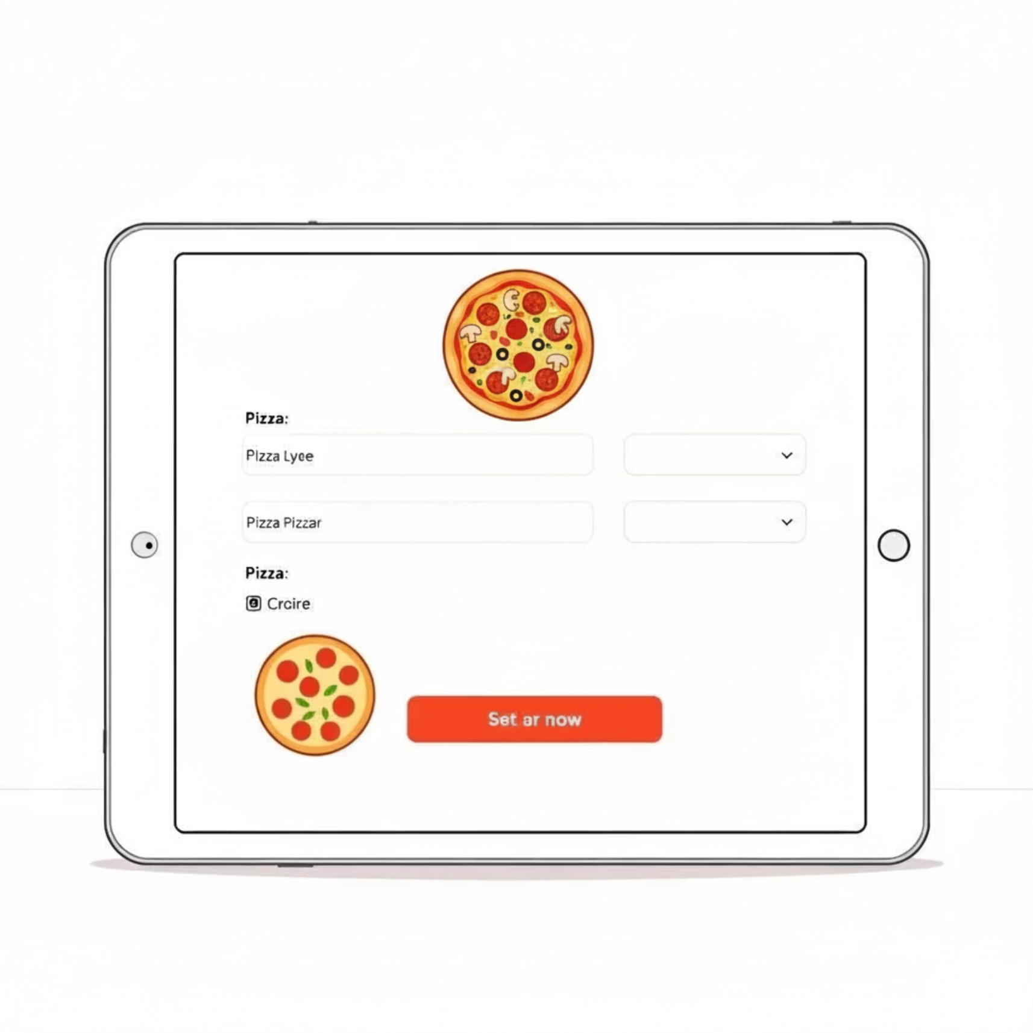
Unified Experience: Consistency Across the Board
A consistent ordering form across all channels simplifies the process for both customers and staff, reducing errors and improving data collection.
Standardized Form Input
Every ordering type—website, phone, or in-person—will utilize the same intuitive form for data entry.
Ensures data consistency and accuracy.
Reduces training time for new staff.
Streamlines order processing for Charlotte.
Improves customer experience with predictable interactions.

Slide 7
